Slide 1

Foreign Employment
Nepal Parichaya
Dec- 2023

Slide 2

Foreign Employment
Definition of Foreign Employment
Going from one country to another country for job and to earn money is called foreign employment. People of Nepal go to different countries of the world for jobs and earning. The Nepalese labor and sweat is being used in foreign countries and there is scarcity of human power for the development of our own country.

Slide 3

Current status of Foreign Employment in Nepal
The trend of Nepali youth seeking foreign employment has increased due to limited local job opportunities. The Ministry of Finance's Economic Survey noted an annual addition of at least 512,000 youth to the Nepali labor market. With over 42,000 new entrants monthly, this number is expected to rise due to declining dependency ratios. Nepal, with 63.7% of its population below 30 years, faces a youth unemployment rate of 19.2%, compared to the national rate of 2.7%. The International Labor Organization (ILO) emphasizes the quantitative challenge with over 400,000 young people entering the labor force annually.

Slide 4
Approximately 512,000 young individuals enter the Nepali labor market annually.
The number of new entrants is expected to grow due to declining dependency ratios.
Nepal has a young population, with 63.7 percent of the overall population below 30 years of age.
The unemployment rate among youth aged 15-29 is 19.2 percent, much higher than the national average of 2.7 percent.
The informal segments of the Nepali economy dominate employment, leading to low productivity, earnings, and poor working conditions.
Underemployment is a prevalent issue in Nepal.
Higher incomes and better working conditions contribute to the increasing migration for foreign employment.

Slide 5
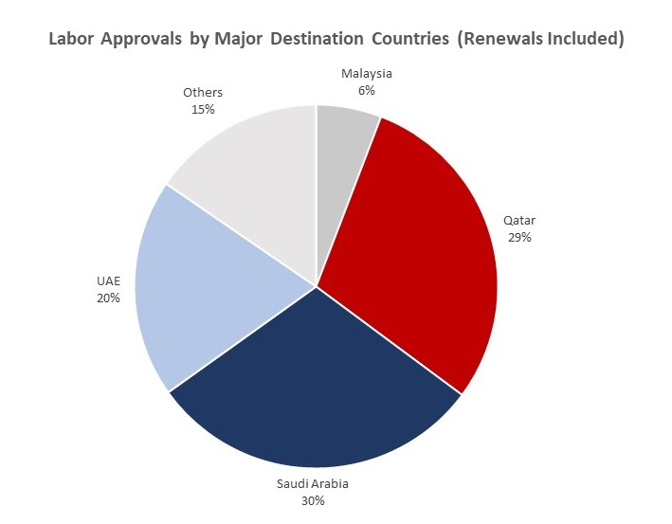
20%
Category Title
5%
Category Title
Category Title

Slide 6
COMPARISON
Everything have advantage and disadvantage some of them are below:
Advantage
Disadvantage
Higher Income
Skill Development
Career Opportunities
Networking and Cultural Exposure
Global Experience
Quality of Life
Financial Stability and Remittances
Cultural Adjustment
Family Separation, Family Issues
Uncertain Job Security
Healthcare Challenges
Isolation
Language Barriers
Stress and Mental Health

Slide 7
Plan Development
Developing a plan for development is crucial to ensure a systematic and organized approach towards achieving your goals. Here are the steps to create an effective development plan:
Define your objectives using the SMART framework.
Assess the current situation, including available resources and challenges.
Identify the key areas that need development.
Set priorities based on importance and impact.
Establish development strategies and action plans for each priority area.
Allocate necessary resources (budget, personnel, equipment, external support).
Create a timeline with clear milestones for implementation.
Monitor progress regularly and make adjustments as needed.
Communicate the plan to stakeholders and seek their support and involvement.
Review and update the plan periodically to remain adaptable and aligned with goals.

Slide 8
Any Questions?

